Slide 1

lOMoARcPSD|7281087
SCHOOL OF COMPUTER SCIENCE AND ENGINEERING
REPORT ON PYTHON PROJECT
BANKING SYSTEM Application
Submitted to Lovely Professional University
“DEGREE OF BACHELOR OF TECHNOLOGY [COMPUTER SCIENCE AND ENGINEERING]”
Submitted By
Name
Bipul Kumar
Yaswanth Sai
Registration No.
12020242
12007278
Submitted To:
Dr. Sagar Pande Sir
Project Link-
https://github.com/bipulkumarb/Bakinng-management-system-in-python.git
1

Slide 2
lOMoARcPSD|7281087
ABSTRACT
The goal of this project was designing a platform by which we can get idea as the balance and check out of bank website and functioning of data in the database of the banking system .
With the help of Python we can able to Receipt and bank statement . We used python to code for this application and had designed the Bank management system.
The adoption of Electronic Banking by commercial enterprises has been inexistence since the mid 90’s. Much greater in number due to lower operating costs associated with it. Electronic banking has initially been in the form of automatic teller machines and telephone transactions.
More recently, it has been transfer made by the Internet, a new delivery channel for banking services that benefits both customers and banks. Internet banking system services can include: Open an account, Balance enquiry, Beneficiary payments (EFT), viewing monthly, Furthermore, customer’s application for electronic transactions over the Internet are significant.
Our Project basically have two main things:
Building UI (front-end).
Write Python Code(Back-end).
All functions of the banking systems are specified.
2

Slide 3
lOMoARcPSD|7281087
Acknowledgement
We take this opportunity to present our votes of thanks to all those guidepost who really acted as lightening pillars to enlighten our way throughout this project that has led to successful and satisfactory completion of this study. We are really grateful to our teacher for providing us with an opportunity to undertake this project in this university and providing us with all the facilities. We are highly thankful to Dr. Sagar Pande for his active support, valuable time and advice, wholehearted guidance, sincere cooperation and pains-taking involvement during the study and in completing the assignment of preparing the said project and in course within the time stipulated.
Lastly, we are thankful to all those particularly the various friends who have been instrumental in creating proper, healthy and conductive environment and including new and fresh innovative ideas for us during the project, their help, it would have been extremely difficult for us to prepare the project in a time bound framework.
3

Slide 4
lOMoARcPSD|7281087
 | TABLE OF CONTENTS
Title Cover Page |  | Page 1
Abstract |  | 2
Acknowledgement |  | 3
Table of Contents |  | 4
List of figures |  | 4
Introduction |  | 5
Home Page and SubPage |  | 6-7
Advantages Disadvantages |  | 8
Administrative Requirement |  | 9-10
Application Details Data Flow Diagram |  | 11 12
Results Personal Contribution Conclusion |  | 13-16 17 18
References |  | 19
 | List of Figures
Figure number | Topic | Page number
1 | Starting of Page | 5
2 | Sub Page | 7
3 | Application details | 11
4 | Results | 13-16
4

Slide 5
Introduction
lOMoARcPSD|7281087
General Information:
Usually all persons want money for personal and commercial purposes. Banks are the oldest lending institutions . They are providing all facilities to all citizens for their own purposes by their terms. To survive in this modem market every bank implements so many new innovative ideas, strategies, and advanced technologies. For that they give each and every minute detail about their institution and projects to public.
They are providing ample facilities to satisfy their customers i.e. et banking, mobile banking, door to door facility, instant facility, investment facility, demat facility credit card facility, loans and advances account facility etc. And such banks get success to create their own image in public ad corporate world. These asks always accepts innovative notations in scenario like credit cards, ATM machines, risk management etc. so, as a student business economics I take keen interest in world economy ad for that also are the main source of development.
So this must be the first choice for me to select this topic. At this stage every person must know about new innovation technology of procedure new schemes and new ventures.
Because of the following reasons, I prefer this project work to get the knowledge of the banking system.
Banking is an essential industry.
It is where we often wind up when we are seeking a problem in financial crisis and money related query.
Baking is one of the most regulated businesses in the world.
Banks remain important source for career opportunities for people.
It is vital system for developing economy for the nation.
Banks can play a dynamic role in delivery ad purchase of consumer durables.
5

Slide 6
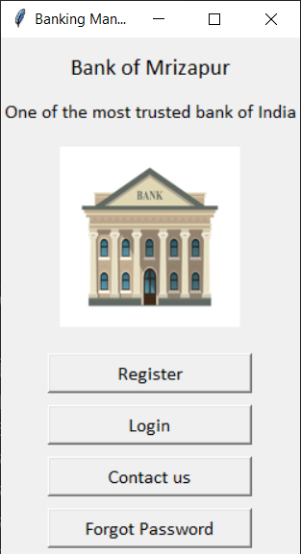
Home Page
lOMoARcPSD|7281087
Home page is a web page set as the default or start-up page on a browser with title and image of platform “Banking System”.
Our home page have following components:-
Header consists of the logo of our platform "Banking System”.
Body of UI have different Background color of body is simple, dark black and lite gray light.
Overall it’s a classical and user-friendly User Interface.
6

Slide 7
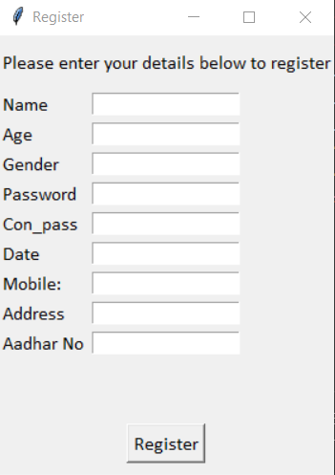
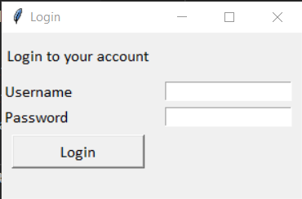
Sub -page
lOMoARcPSD|7281087
The above pop up will appear when we will click on Register button. Here we can enter our personal details.
The above pop will appear when we will click on Login button.
7

Slide 8
Advantages:-
1.User Friendly- No Special training required to use our Banking . Management System.
2.If the user has forgot the password ,they can change it.
3.User can contact to the bank through contact us page.
4.Multiple user can use it.
5.Application is available in classic and light theme.
6.We can run the program multiple times.
Disadvantages:-
1.Our system is only for customers .Bank employee can not use it.
2.Few bugs are present.
3.Informations are not stored at internet.
4.Cannot change the location where the files will be stored.
8

Slide 9
Administrative Requirement Functional Requirement: functional requirements in our systems are as follows: -→ purpose : To register a new customer. -→Inputs : The required data for registration of a new customer in the bank (Like Name, Age , Gender etc ). -→Objects : A Success Message be displayed on successful registration or else an error message will be displayed.
Requirements :-
As some of the banking site doesn’t have a user friendly interface. So, we decided to develop a “Bank Manager” that will contain all those features fulfilling the client basic need by having a professional yet welcoming Interface. “Bank- Manager” is providing solution to that problem.
Our System is a user specific and is for all types of users. Our System operates on window’s operation system. Easily accessible to all type of users.
Key notes of the Bank Management steps:-
Dealing in money- money given by depositors.
Acceptance Of Deposit:- A bank accepts money from the people in the form of deposits which are usually repayable o demand or after the expiry of a fixed period. It gives safety to the deposits of its customers. It also acts as a custodian of funds of its customers.
Giving Advances: a bank provides various banking facilities to its customers..
Payment & with withdraw- A bank provides easy payment and withdrawal facility, It also brings bank money in circulation. This money is in the form of cheques, drafts, etc.
9

Slide 10
Agency & Utility Services:- A bank provides various banking facilities to its customers. They include general utility services and agency services.
Profit & Services Orientation:- A bank is a profit seeing institution having service oriented approach.
Ever Increasing Function:- Banking is an evolutionary concept. There is continuous expansion and diversification as regards the functions, services ad activities of a bank.
Connecting A link :- A bank acts as a connecting link between borrowers and lenders of money. Banks collect money from those who have surplus money ad give the same to those who are in need of money.
Banking Business:- A bank’s main activity should be to do business of baking which should not be subsidiary to ay other business.
Report :-
Client Report:- We can show saved data regarding account management within the database.
Account Report:- We can show the money transaction by client, time, data, and the total amount of account.
Final Report:- At last the final reports, which will show every record regarding client, total amount and withdraw by client.
Security Requirement:-
Account ID and Password (PIN) Protection
Sign-off Button
Failed Log-on Attempts
Encryption
10

Slide 11
Application Details
lOMoARcPSD|7281087
1.First we have to register our selves.
2.Login in to make transactions.
3. When we have logged in we can deposit money, withdraw money and see our personal details.
4.The date at which user are making the transaction are stored in the system.
5.If user have forgot our password they can change it.
6.If user are facing any problem they can contact to the bank.
8.All the complaints are stored in the system.
11

Slide 12
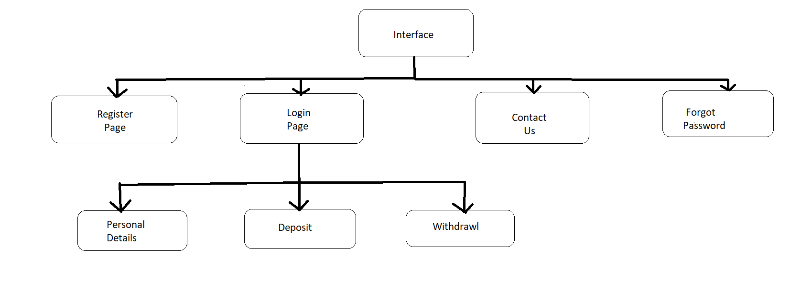
Data Flow Diagram
12

Slide 13


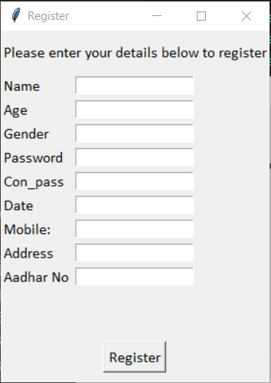
Results
lOMoARcPSD|7281087
Interface
13
Enter your details to register

Slide 14
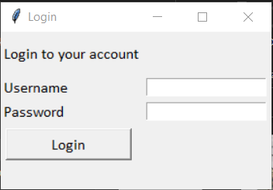

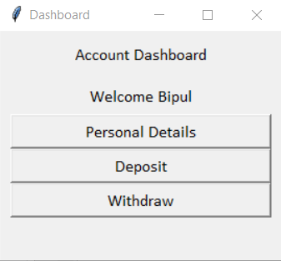
lOMoARcPSD|7281087
Enter Username and Password to Login
Account Dashboard
14

Slide 15
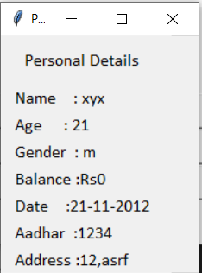

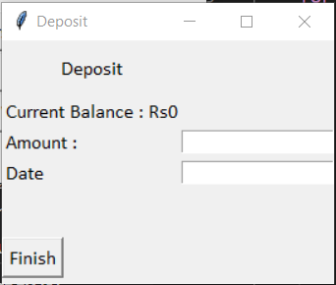
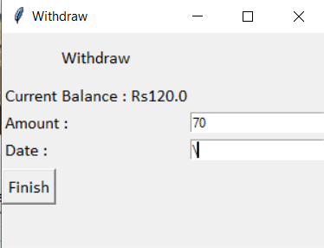
Personal Details
Deposit Withdraw
15

Slide 16
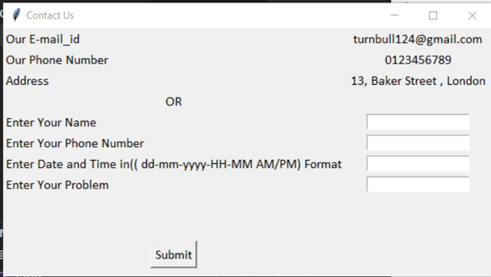

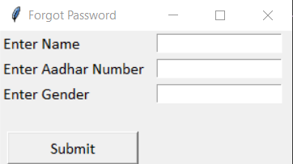
Contact Us
Forgot Password
16

Slide 17
Project Contribution
Bipul
1.Code
a . Login
b . Personal Details
c . Deposit
d . Withdraw
e . Contact Us
f . Forgot Password
2. Report
a . Screenshots
b . Data Flow Diagram , Application Details
c. Advantages and disadvantages
Yaswanth
1.Code
a . Interface
b . Register
2. Report
a. Abstract , Acknowledgement
b. Introduction , Home Page, Conclusion
c. Administrative Requirement
17

Slide 18
Conclusion
The Bank Account Management System is an application for maintaining a person's account in a bank. In this project I tried to show the working of a banking account system and cover the basic functionality of a Bank Account Management System.
To develop a project for solving financial applications of a customer in banking environment in order to nurture the needs of an end banking user by providing various ways to perform banking tasks.
Also to enable the user’s work space to have additional functionalities which are not provided under a conventional banking project.
The Bank Account Management System undertaken as a project is based on relevant technologies. The main aim of this project is to develop software for Bank Account Management System.
This project has been developed to carry out the processes easily and quickly, which is not possible with the manuals systems, which are overcome by this software.
18

Slide 19

References
lOMoARcPSD|7281087
1.https://www.geeksforgeeks.org/python-gui-tkinter/
2.https://www.geeksforgeeks.org/working-images-python/
3.https://www.smashingmagazine.com/2018/01/visual-studio-code/
4.https://www.youtube.com/watch?v=ng5H3lGZ4m8&ab_channel=johangodinho
5.https://www.slideshare.net/chsajiid/banking-management-system-project-documentation
6.https://www.udemy.com/course/python-programming-beginner-to- advanced/learn/lecture/17436246?start=15#overview
7.https://code.visualstudio.com/
8.https://www.python.org/
9.https://docs.python.org/3/library/tkinter.html
10.https://pypi.org/project/Pillow/
11.https://stock.adobe.com/sk/search/images?k=cartoon+bank
12.https://www.researchgate.net/publication/301293322_Bank_Account_Management_System
Thank You!
19

